Slide 1

E-commerce Sales Analysis Big Data Project Proposal
Uncovering Insights for Business Growth
Anisha Singh
Sonal Mogra

Slide 2

Agenda
Introduction
Project Overview
Methodology
Data Set
Data Analysis

Slide 3

Introduction
• Big Data is the term used for such vast collections of data, special methods, and personalized resources. Big data analytics (BDA) allows e-commerce businesses to make better use of data, increase conversion rates, boost judgment, and inspire consumers.
•Big data offers big e-commerce possibilities, helping the virtual e-commerce store to deeply engage and research its digital client. The right application of Big Data Analytics to e-commerce may change their online retailer experiences by "one before" and "one after."
This Photo by Unknown author is licensed under CC BY-SA-NC.

Slide 4
Project Overview
This project aims to leverage big data analytics to enhance our understanding of e-commerce sales dynamics.
Our project's primary goal is to analyze e-commerce sales data to drive informed business decisions.
We will explore the objectives, methodology, data sources, and expected outcomes.
The insights gained will help optimize product offerings, pricing, and marketing strategies.

Slide 5

Methodology
Data Collection
Gather data from various sources, transaction records, and customer feedback.
Data Processing
Use of Apache Spark for cleaning, transforming, and preparing the data for analysis.
Data Storage
Cloud Storage (AWS S3).
Data Analysis and Visualization
Python libraries (NumPy).
Use of application Tableau reporting and analyzing the data.

Slide 6
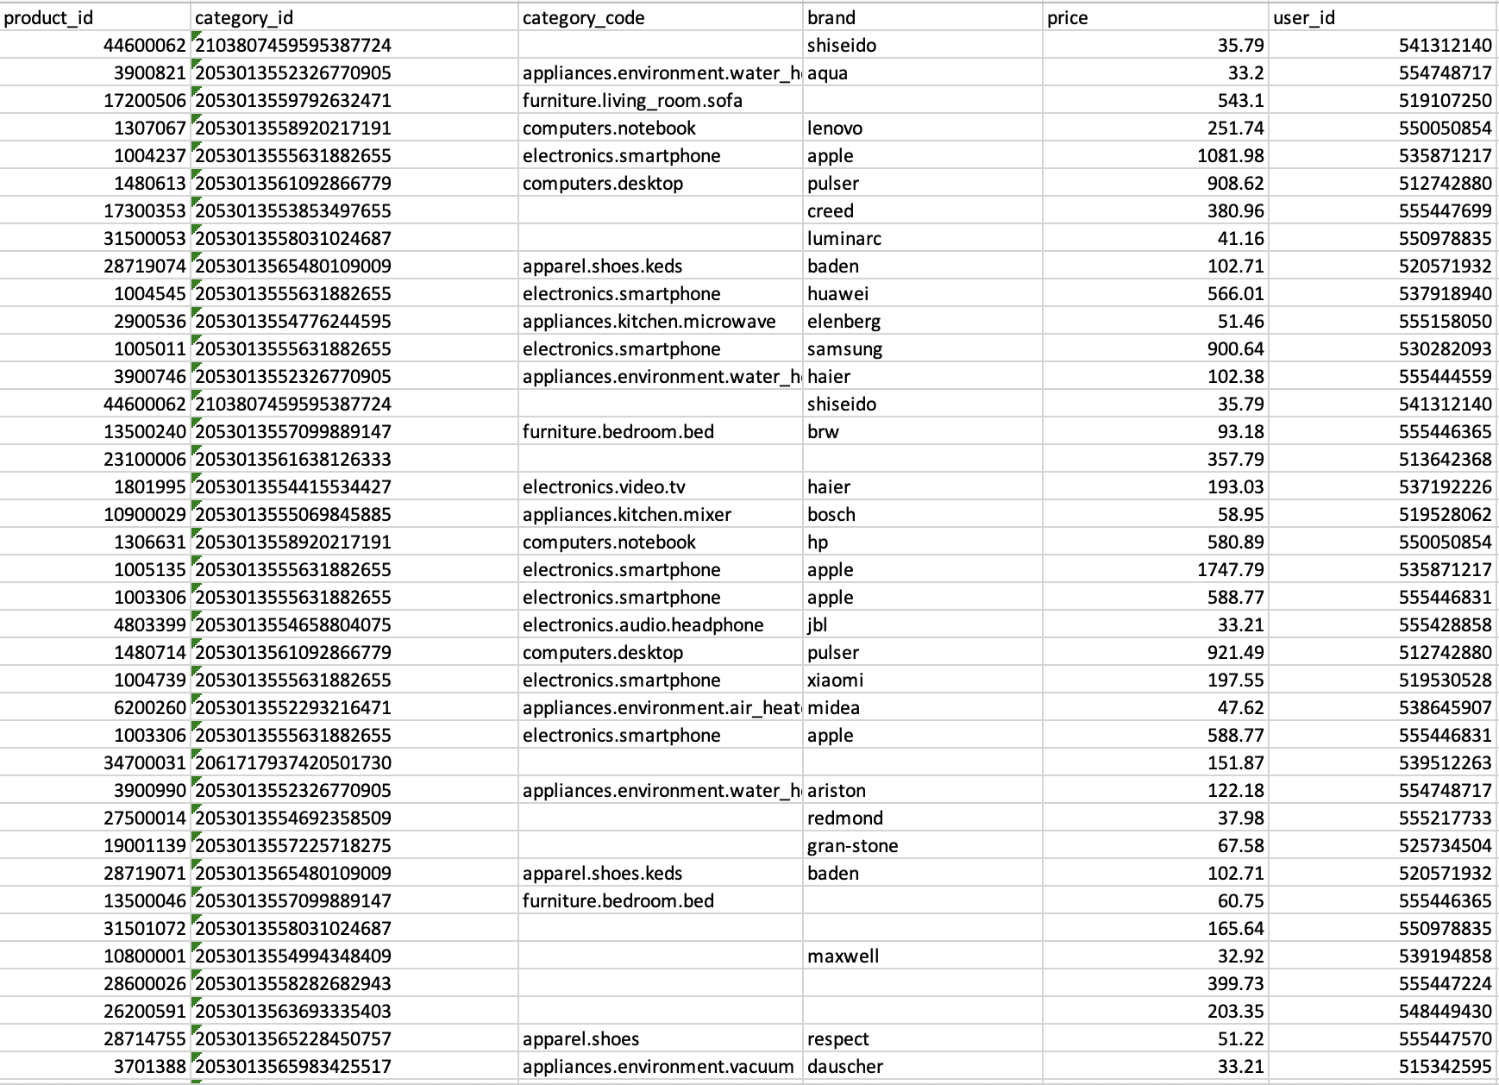
Data set

Slide 7


Data analysis
Descriptive Analysis of Multi category store
Customer Segmentation based on their behavior and preferences
Sales trends and seasonality.
Product performance analysis.

Slide 8

Q&A?

Slide 9


